Slide 1
Calculator.
1 number calculator .
2 Currency convertor
3 unit convertor .

Slide 2
calculator
Java project
Team - Samiksha Gawande 20190201039
Ankit Dhahake 20190201024
Asmita Kutwal 20190201088
Gargi Pawae 20190201050
Triveni Ingle 20190201034

Slide 3
calculator
Table of contents
Introduction
Algorithm
Coding
Conclusion

Slide 4
calculator
1 number calculator
INTRODUCTION
Calculator used to calculate numbers.
Used for addition, subtraction , division, multiplication ….

Slide 5

calculator
INTRODUCTION
A currency converter is a software code that is designed to convert one currency into another in order to check its corresponding value .
In this project by the knowledge of usage of currency converter a program is designed in java.
In this currency convertor application, it is going to display a wed page where you can choose to display the convertor or the exchange rate of one currency with all other currencies in the form of table .

Slide 6
calculator
unit convertor
INTRODUCTION
Unit convertor is use for converting value from one unit to another unit.
You can convert values of length, weight etc.

Slide 7
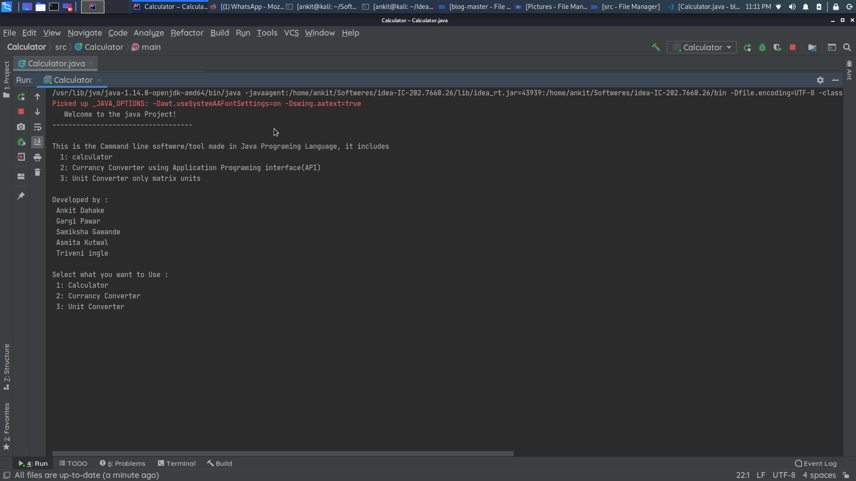
1 number calculator
ALGORITHM Step 1:start

Slide 8
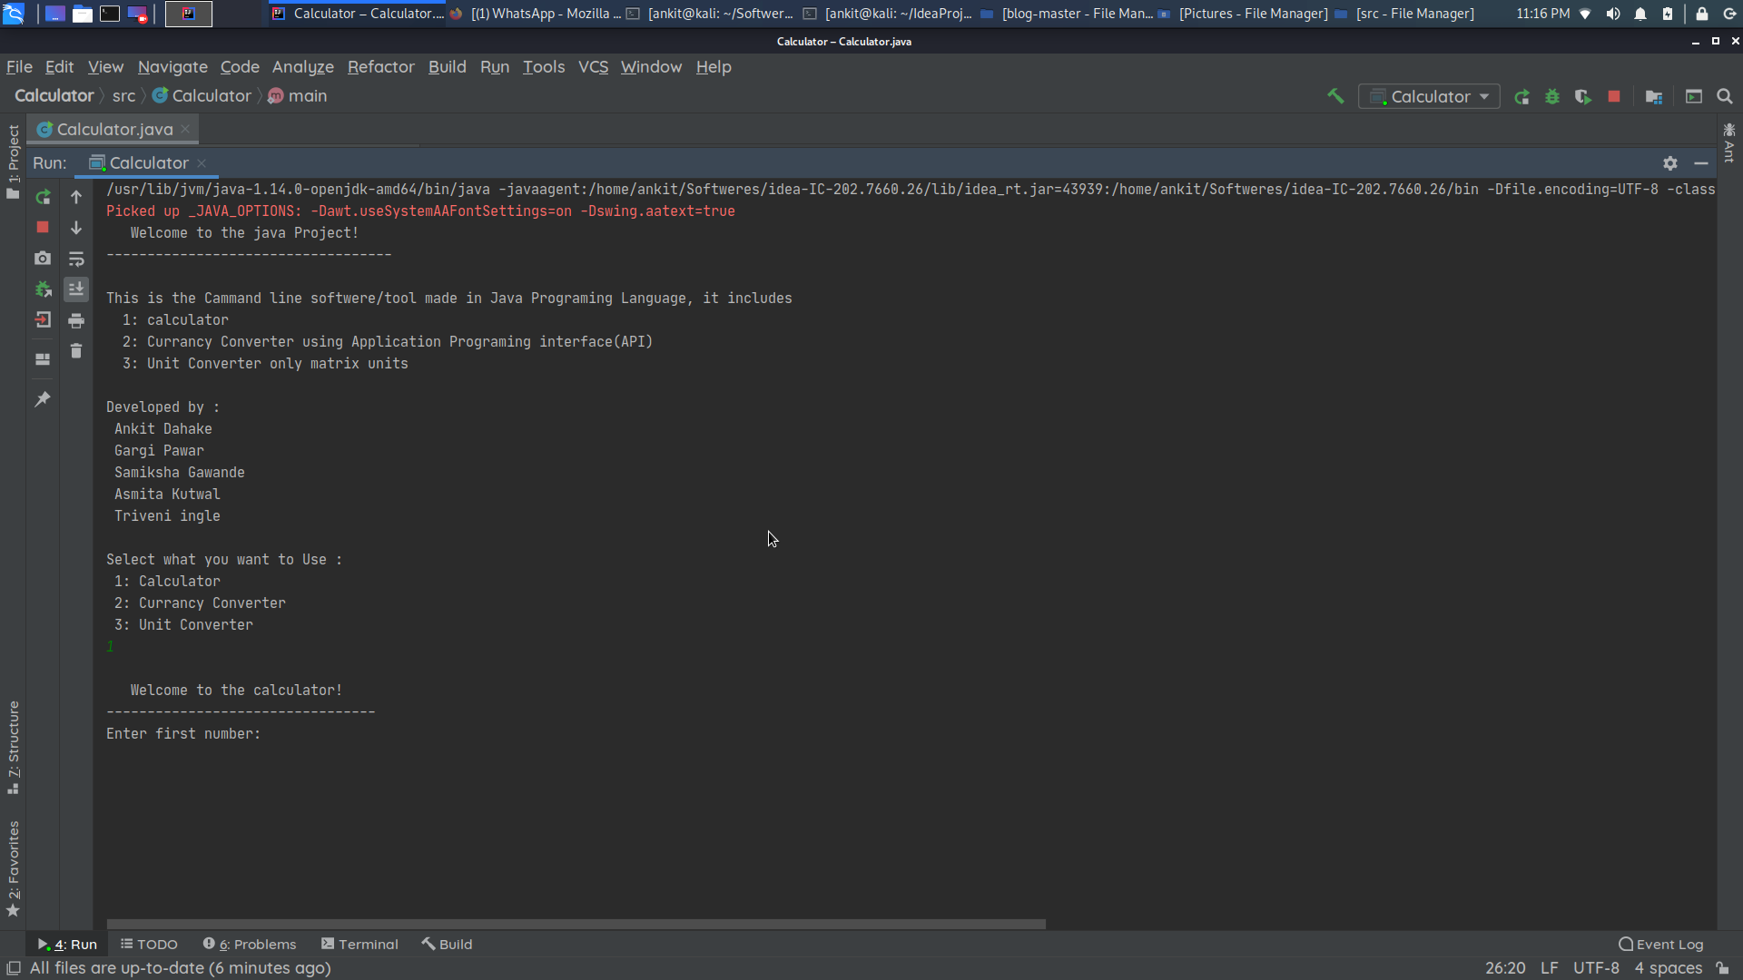
Step 2: type one for calculator

Slide 9
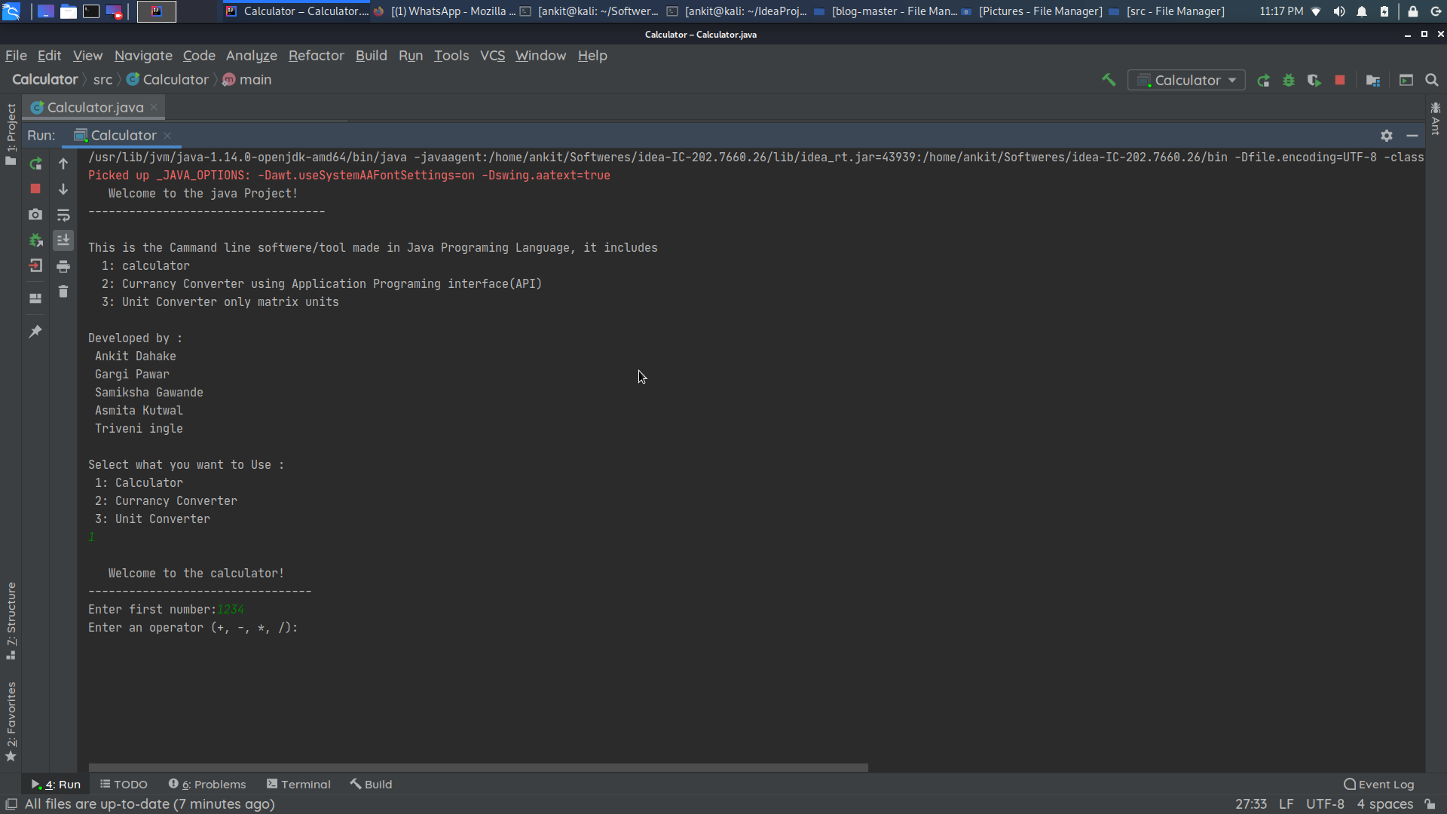
Step 3:enter first number

Slide 10

Step 4: select the operation

Slide 11
Step 5: enter second number

Slide 12
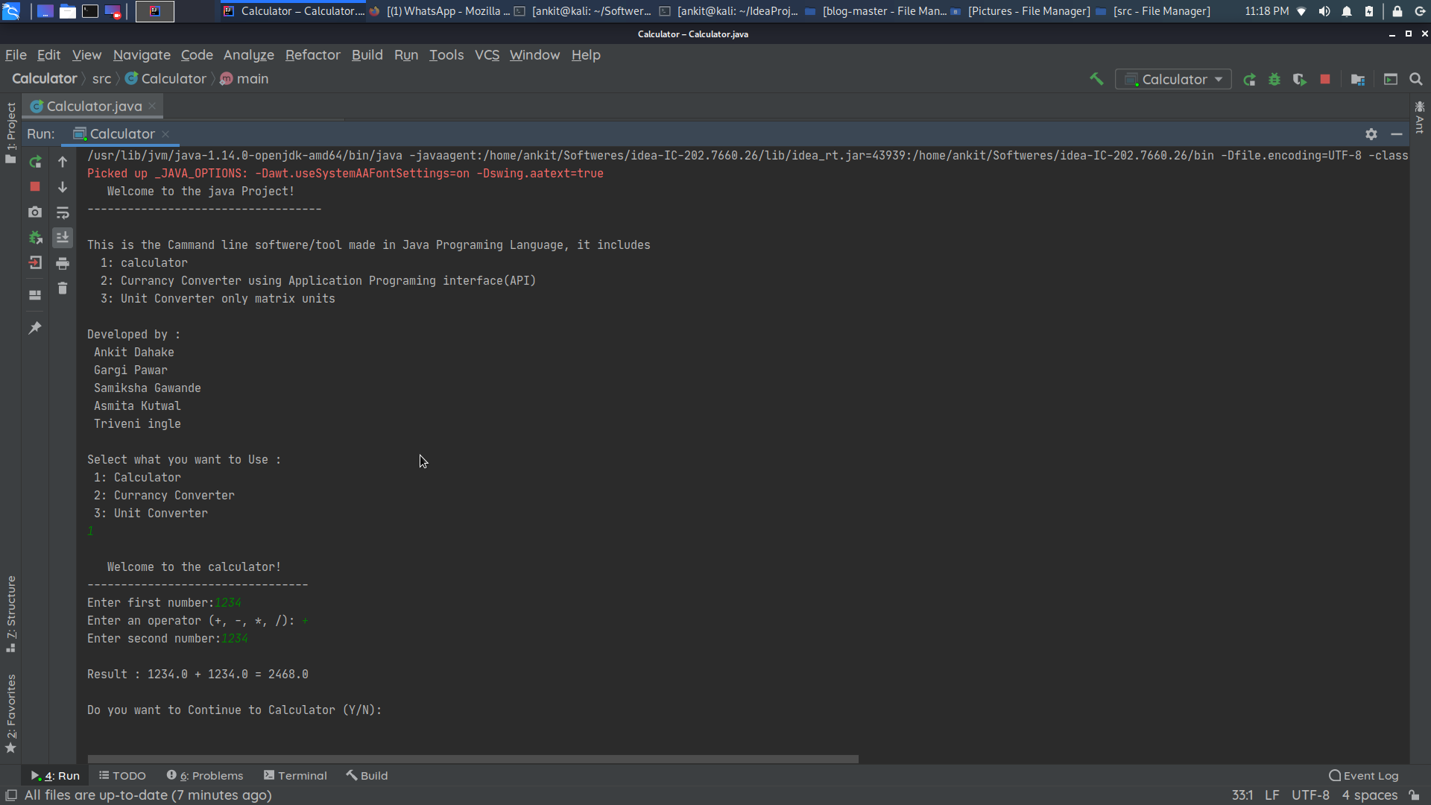
Step 6:result, type y for yes n for no

Slide 13
type y TO ENTER IN MAIN MENU

Slide 14
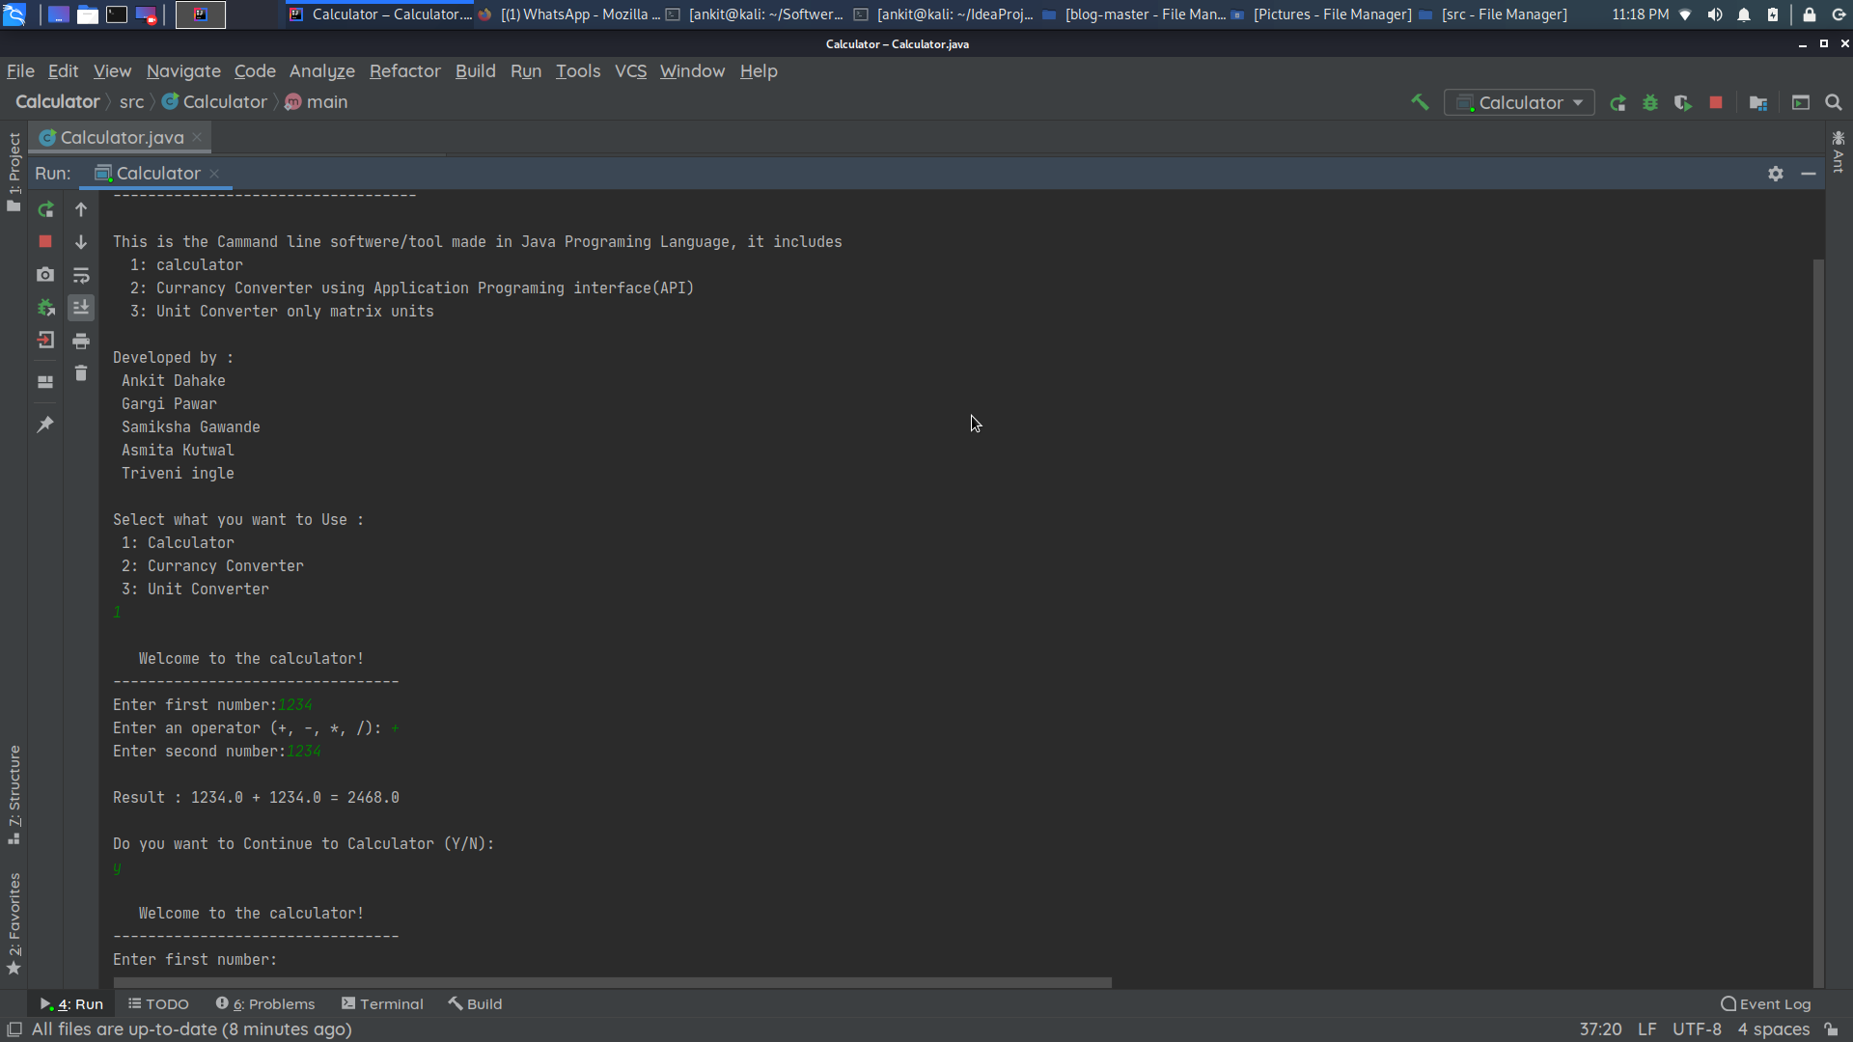
2 Currency convertor
STEP 1:TYPE 2 TO START CURRENCY CONVERTOR

Slide 15
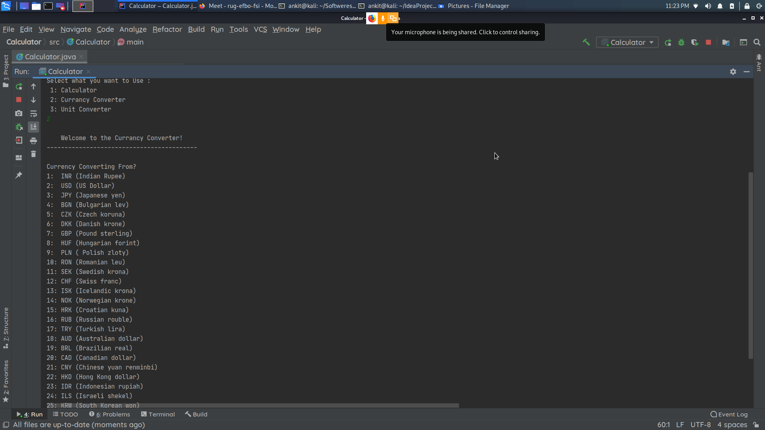
STEP 2:SELECT CURRENCIES

Slide 16
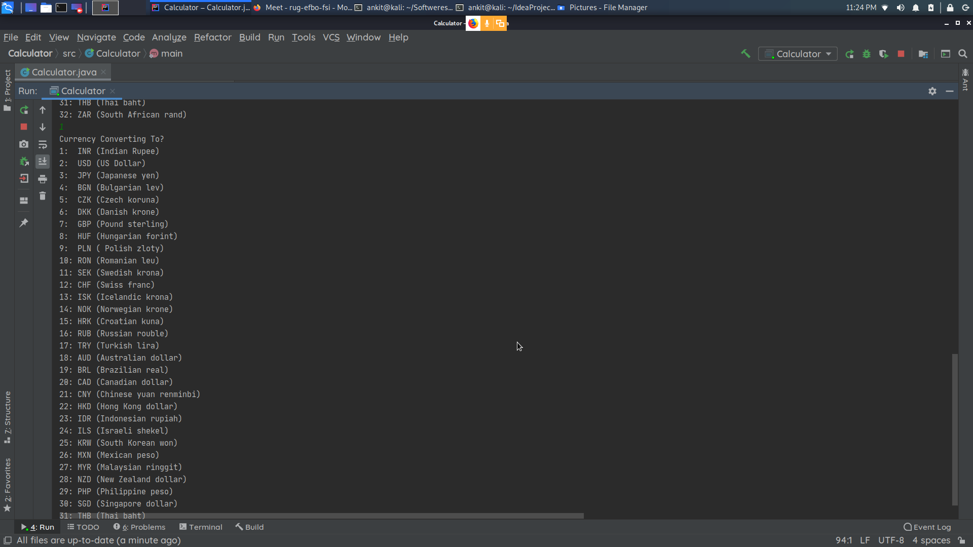

Slide 17
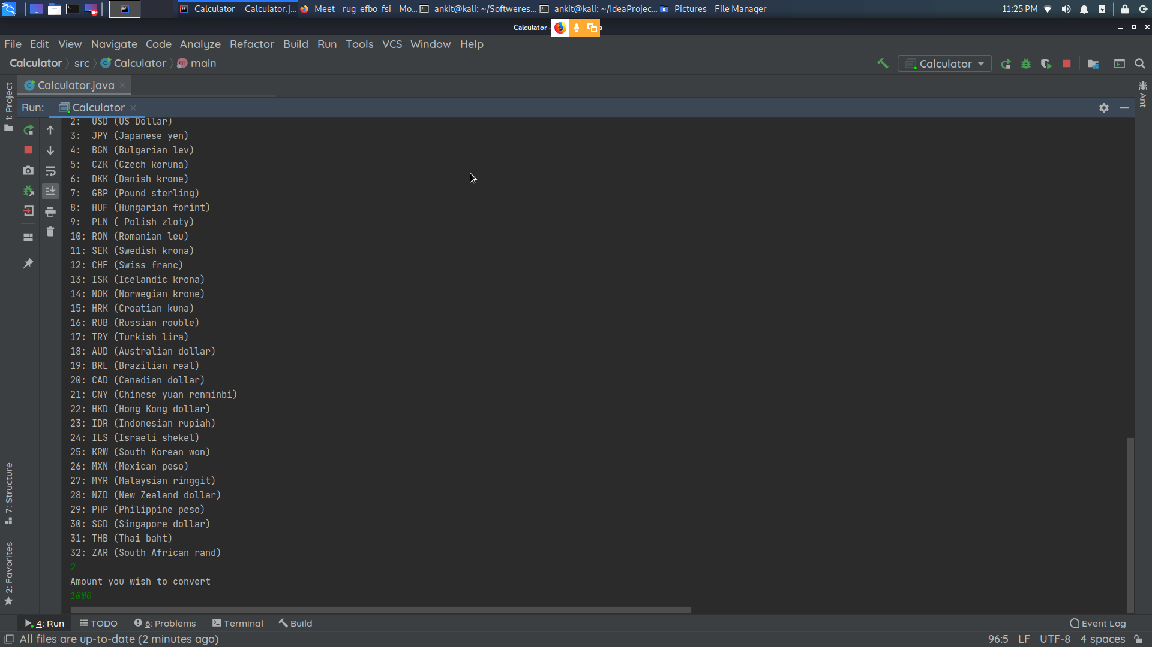
STEP 3:ENTER AMOUNT

Slide 18
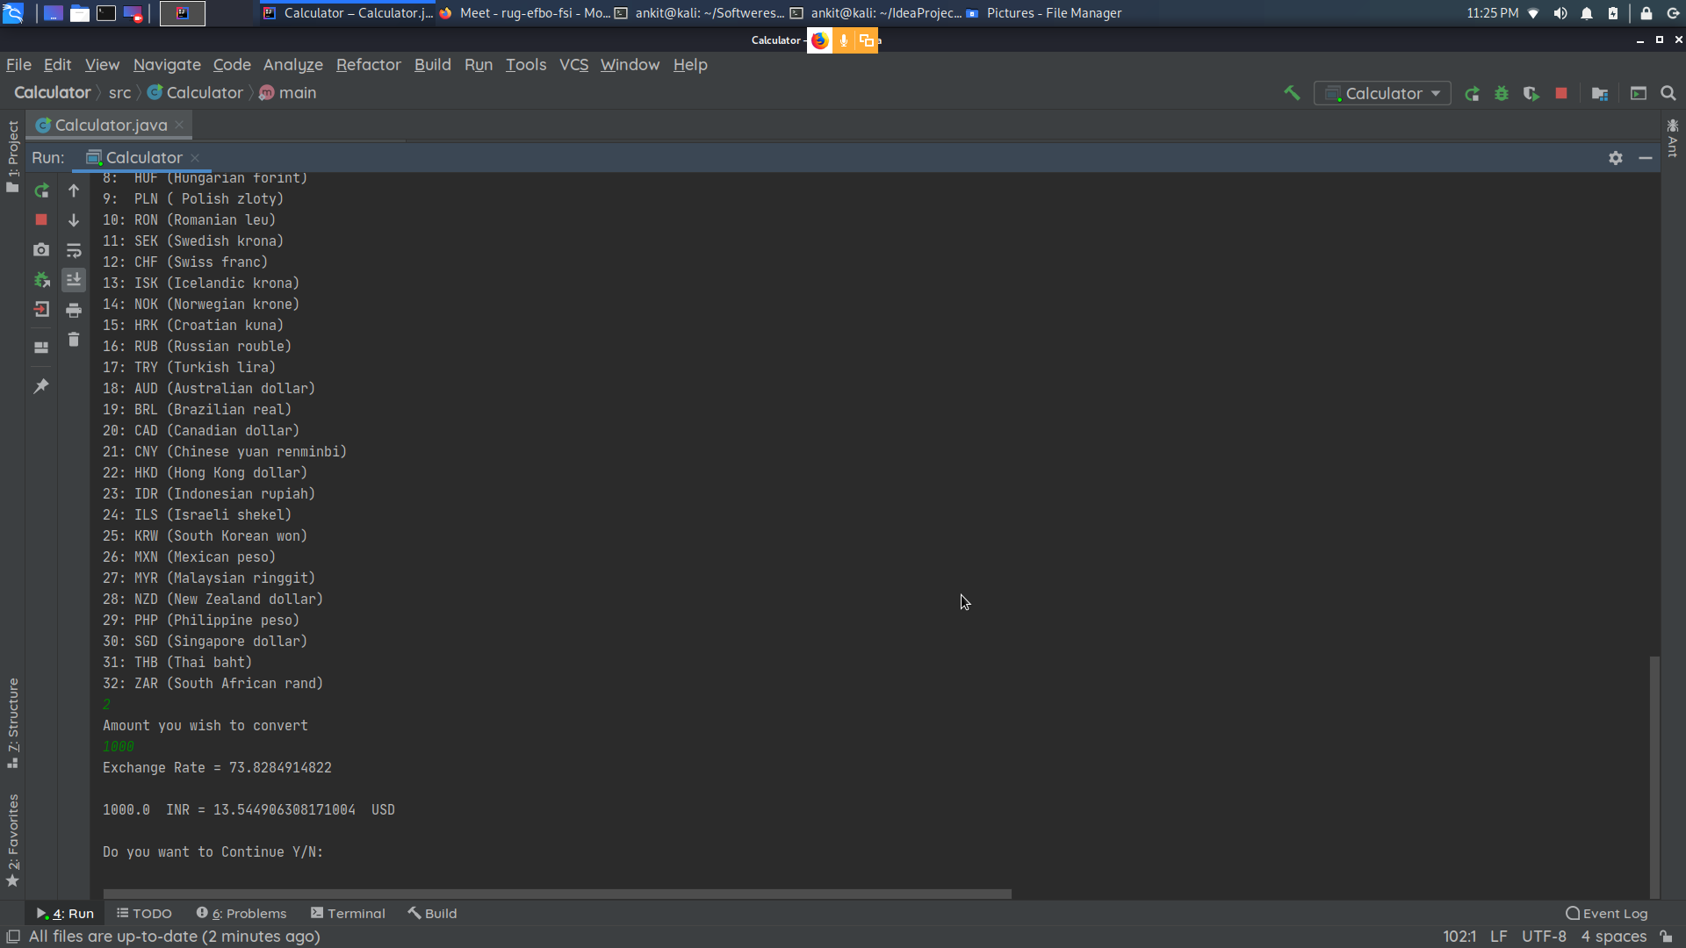
STEP 4:RESULT

Slide 19
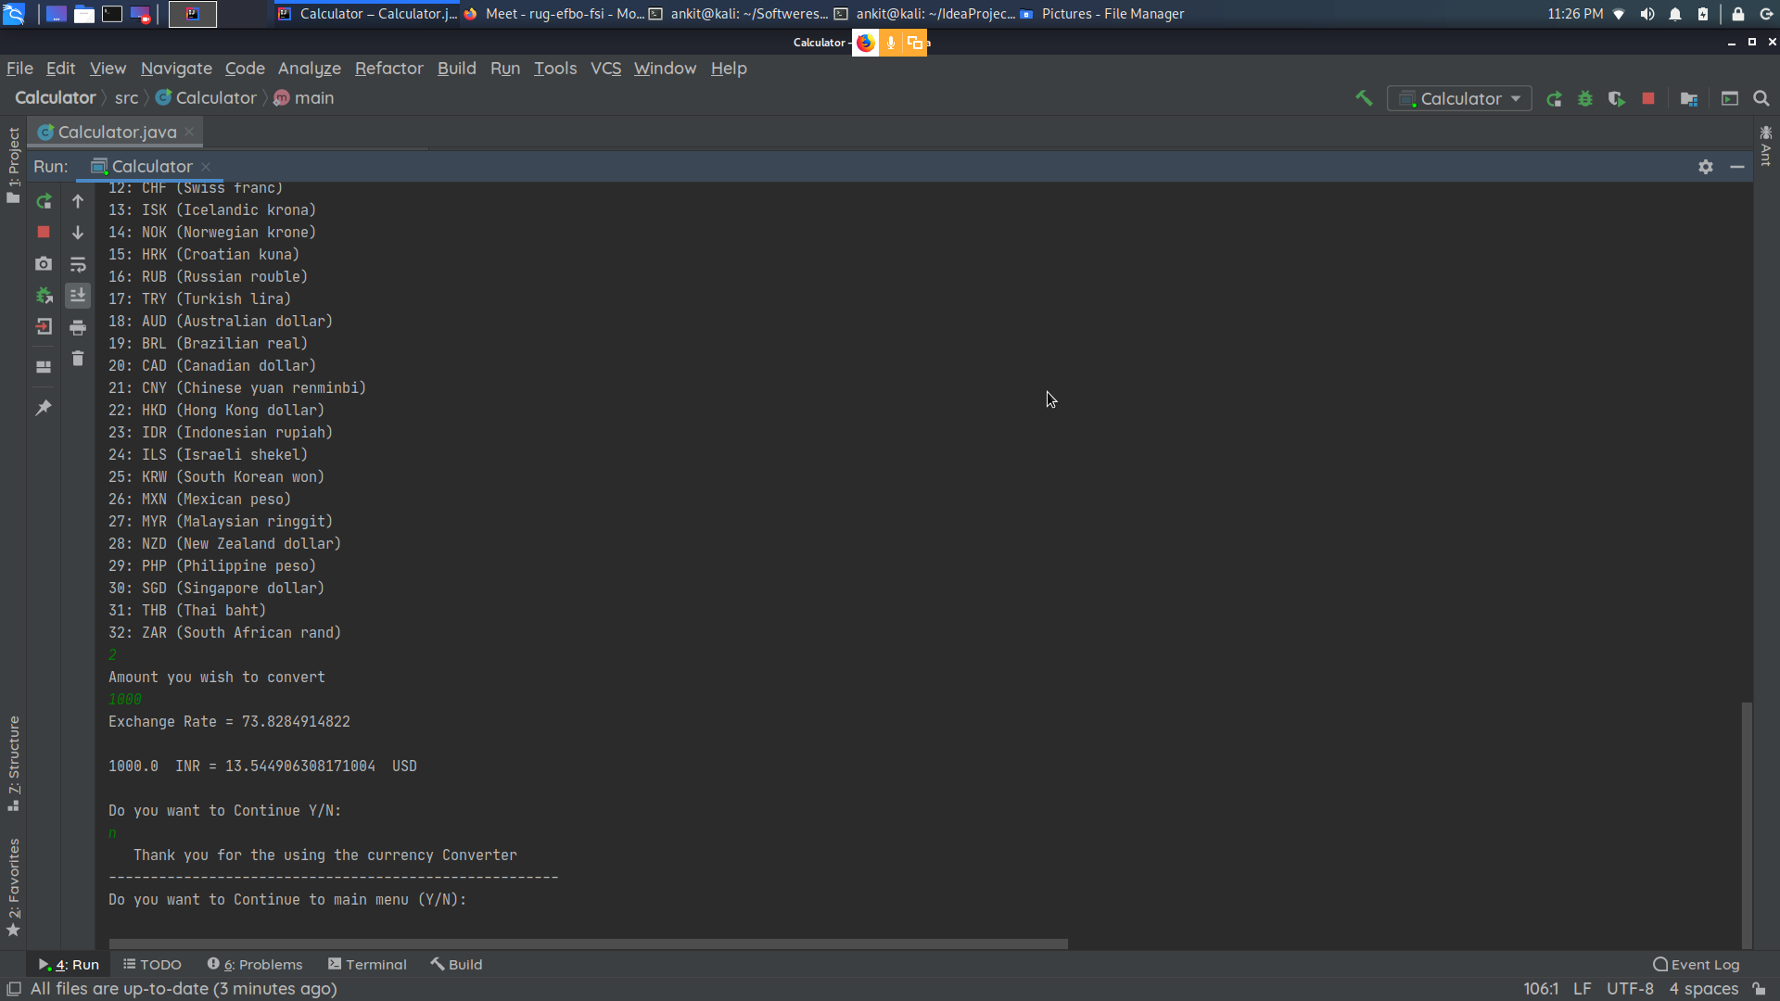
STEP 5:TYPE Y TO CONTINUE WITH CURRENCY CONVERTOR OR TYPE N TO ENTER IN MAIN MENU

Slide 20
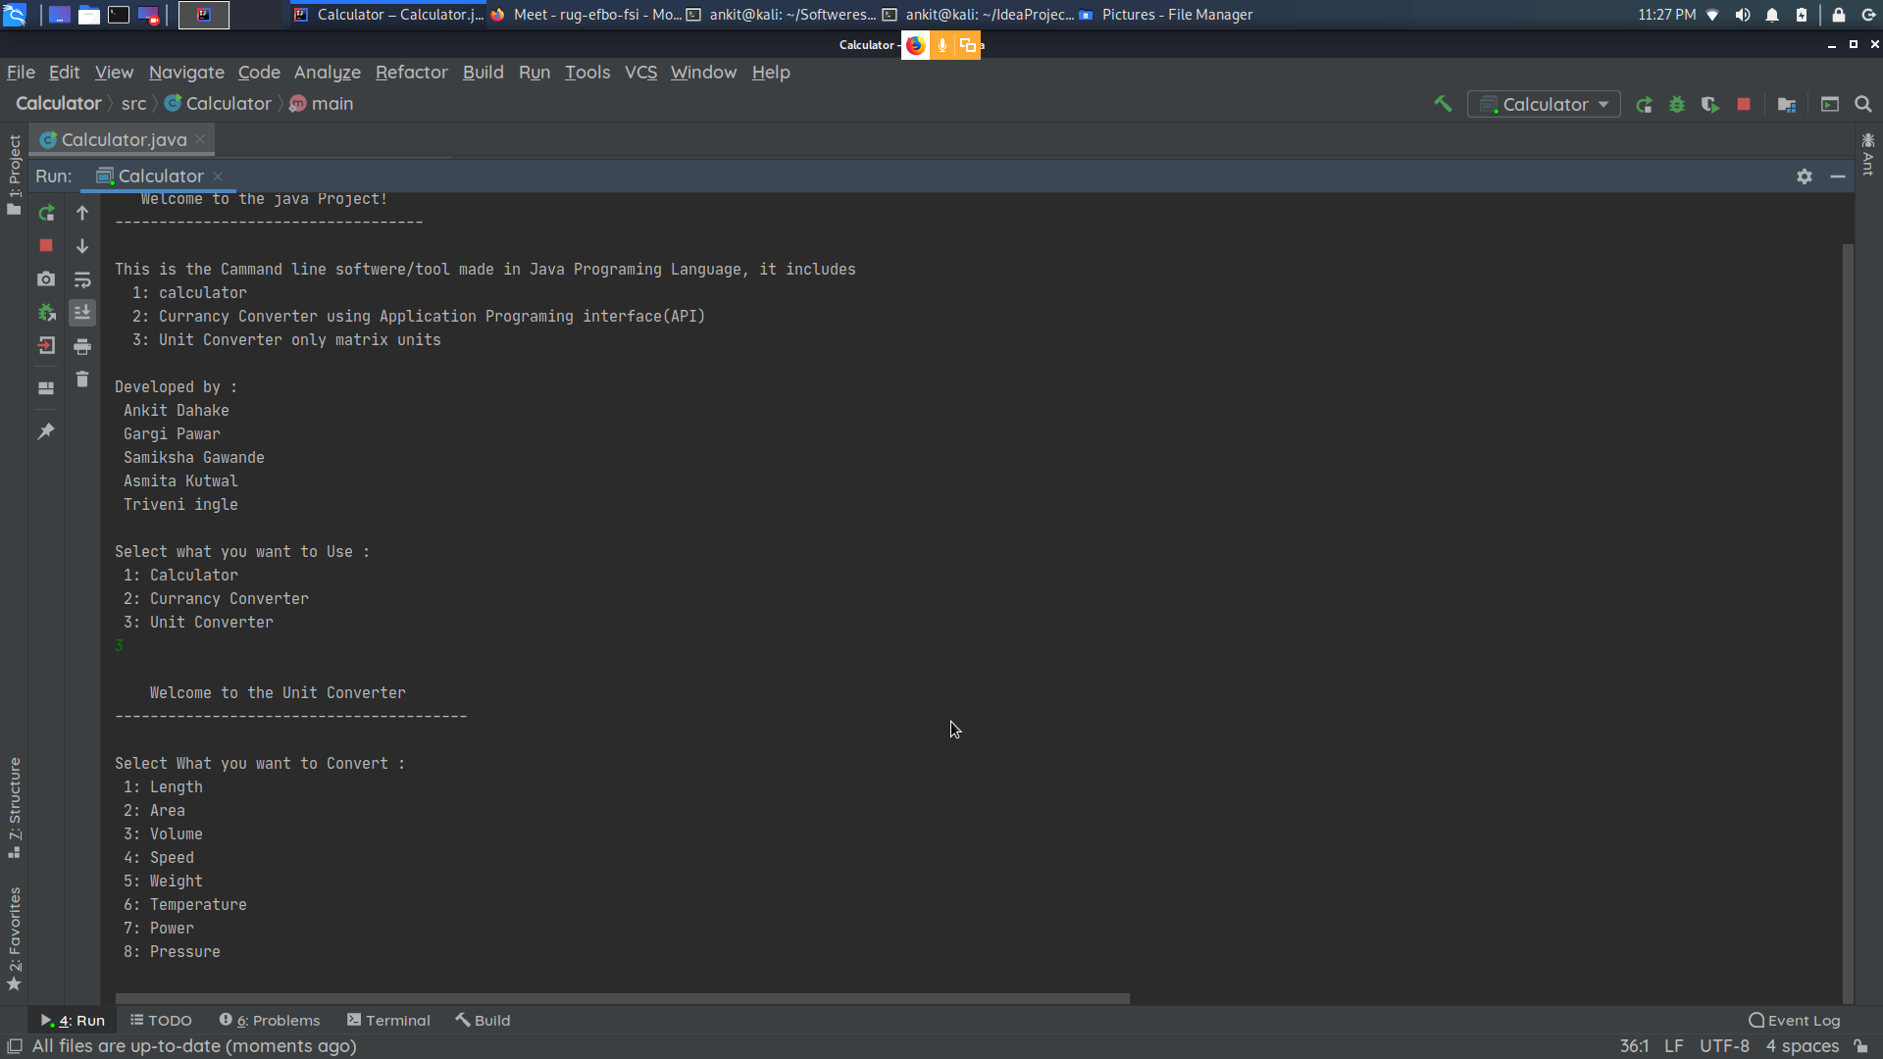
3 unit convertor
STEP 1: TYPE 3 TO ENTER IN CURRENCY CONVERTOR

Slide 21
STEP2: SELECT THE PARAMETER THAT YOU WANT TO CHANGE

Slide 22
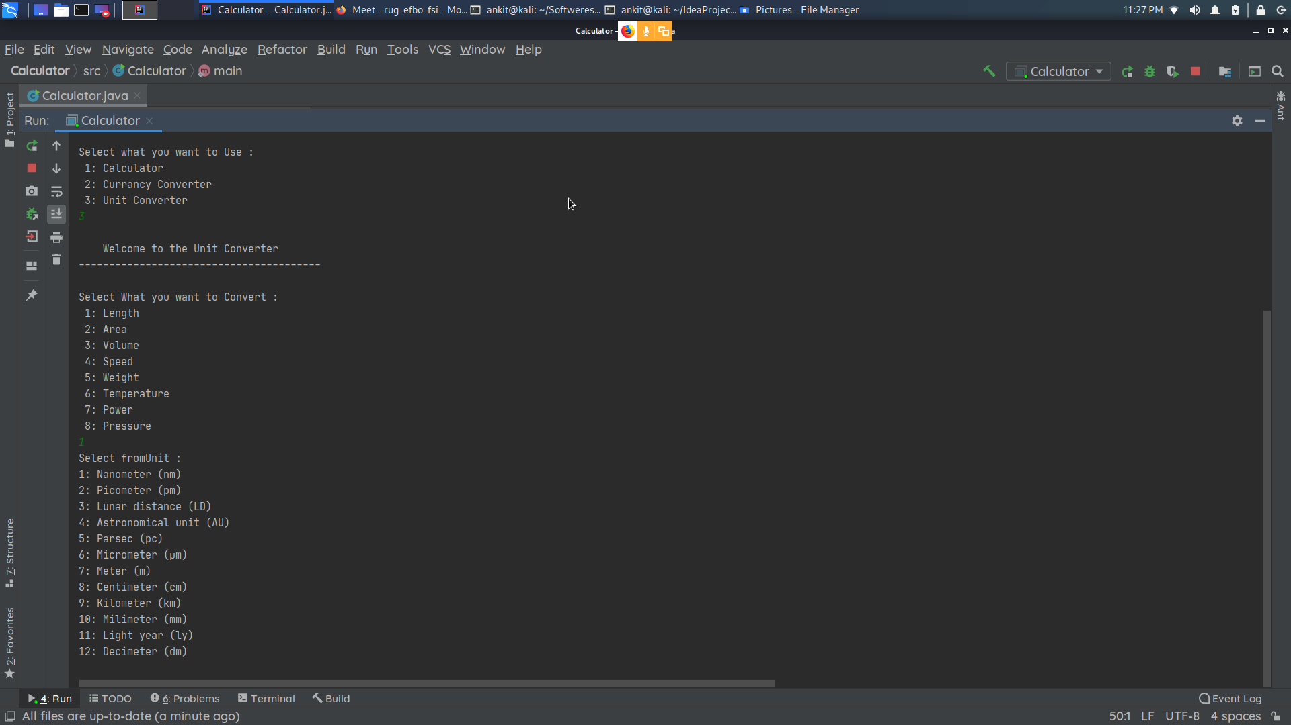
STEP 3:SETECT THE UNIT FROM WHICH YOU WANT TO CONVERT TO ANOTHER

Slide 23
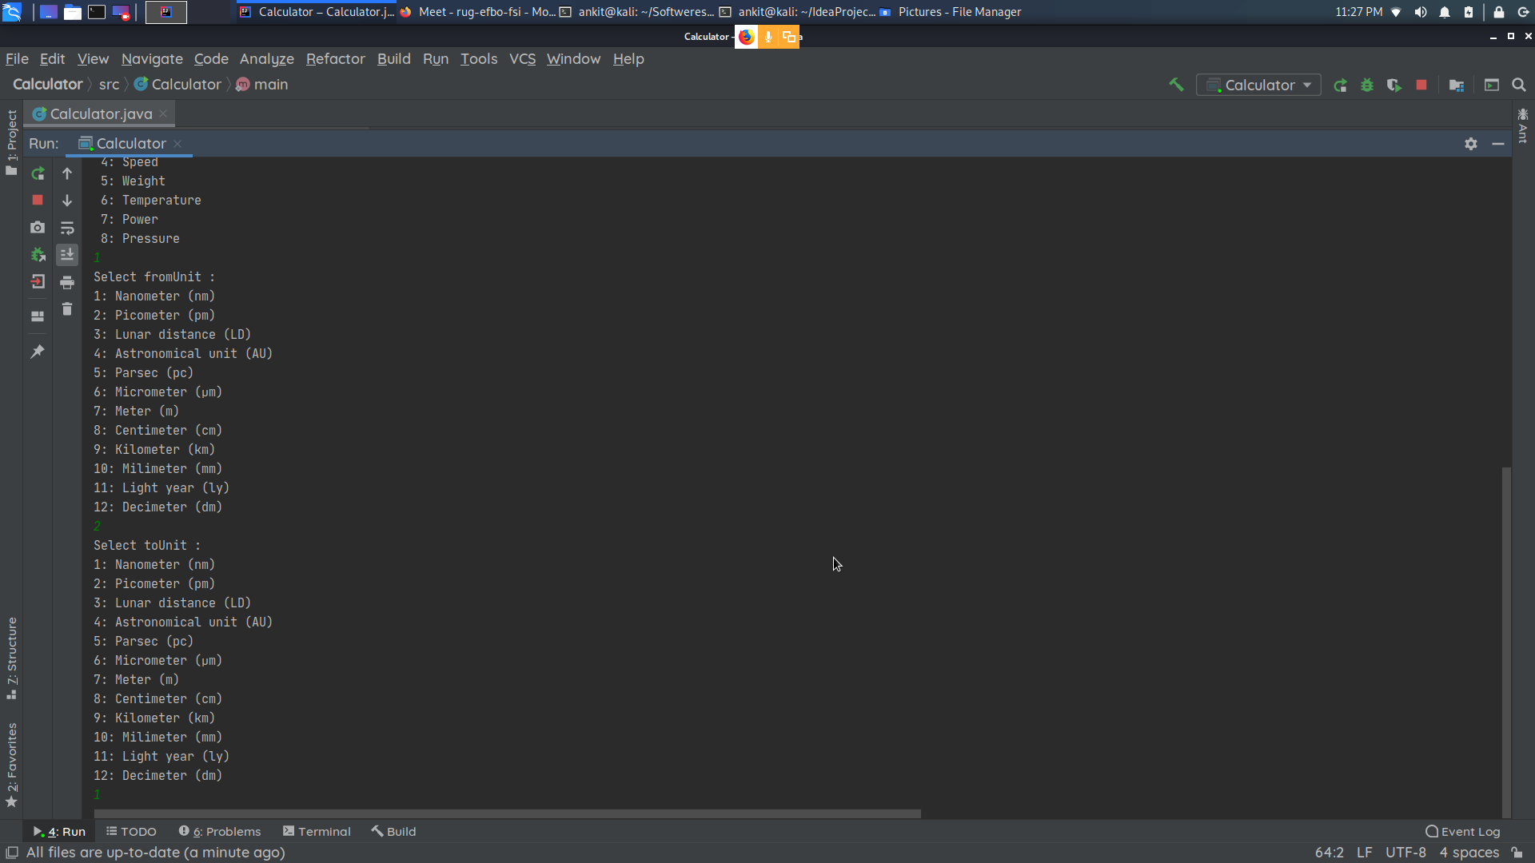
STEP 4:SELECT THE UNIT IN WHICH YOU WANT TO CONVERT

Slide 24

STEP 5:RESULT WILL BE DISPLAYED

Slide 25
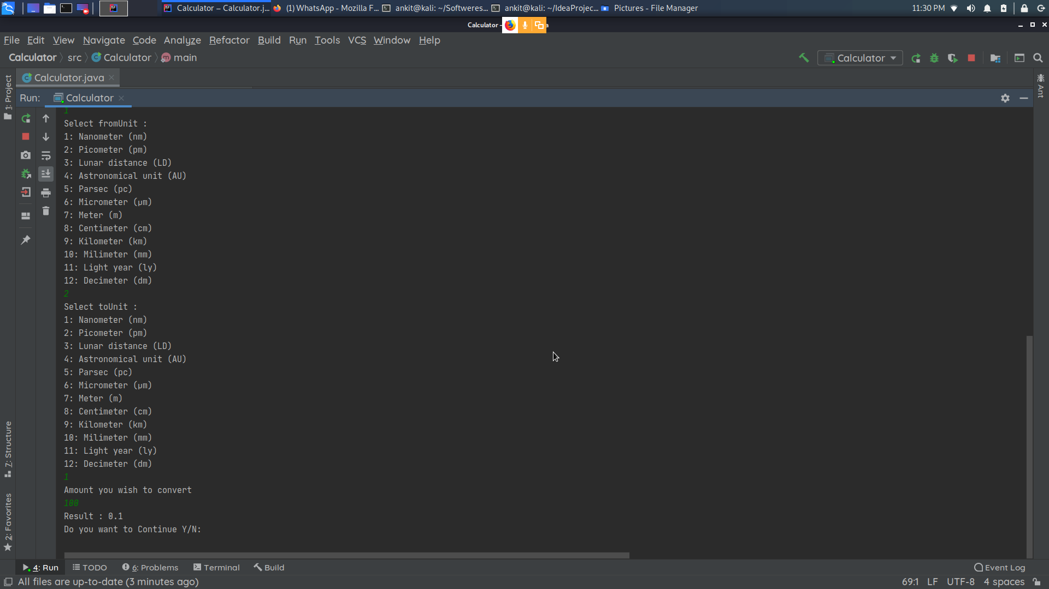
STEP 6: TYPE Y TO CONTINUE WITH CURRENCY CONVERTOR OR N TO ENTER IN MAIN MENU

Slide 26
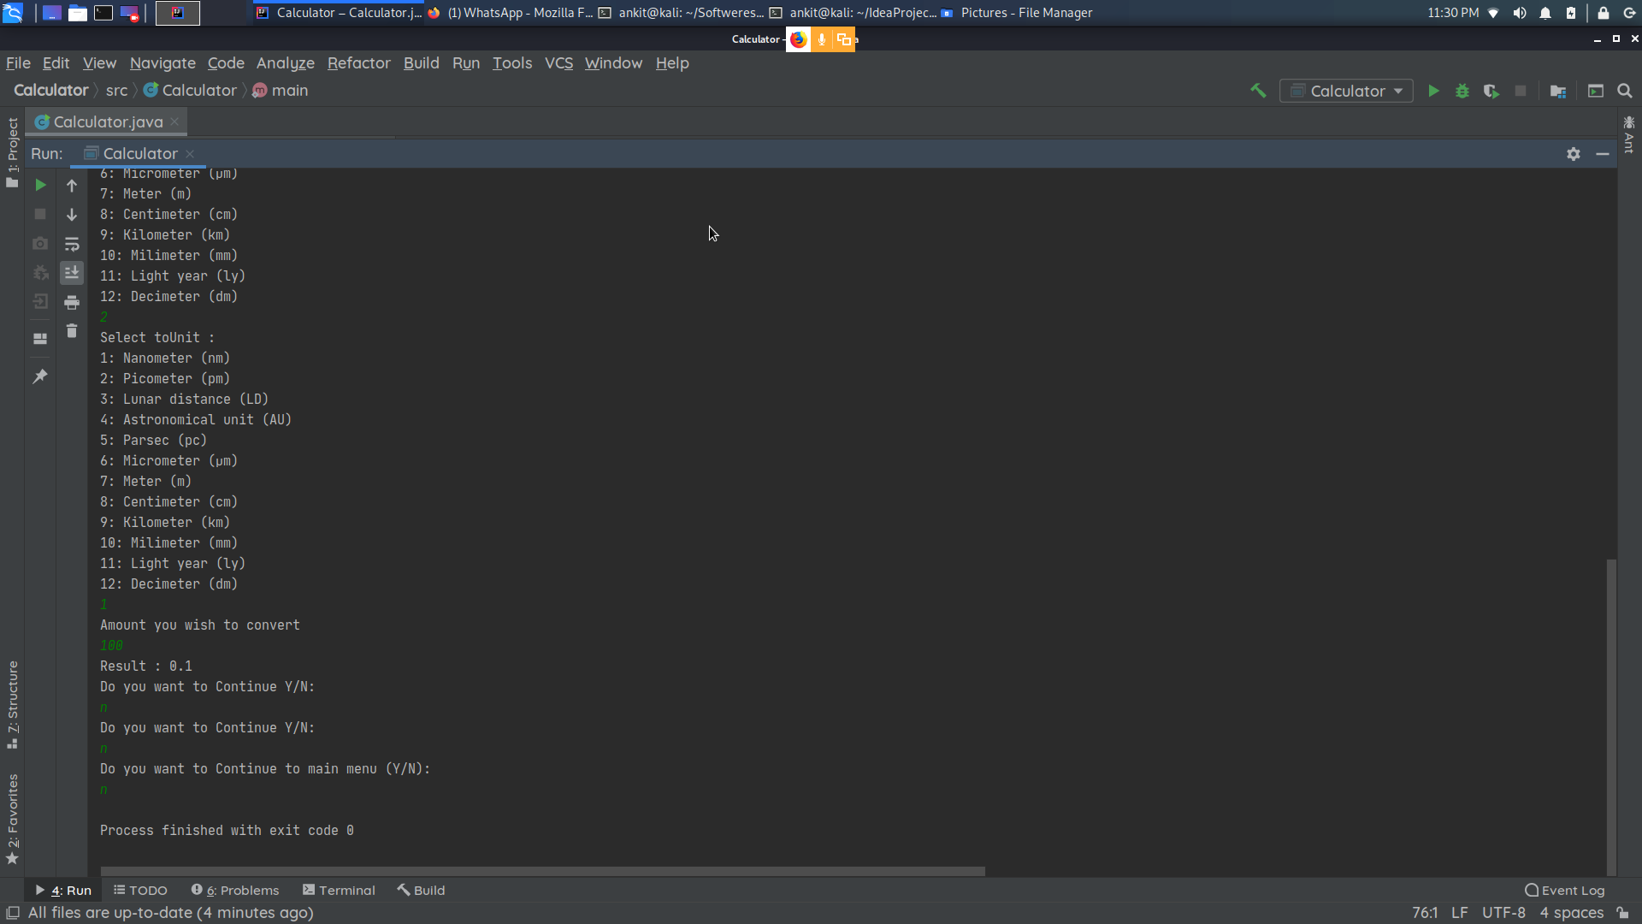

Slide 27
Thank you

